Slide 1
Fitness for Life
Unit 5

Slide 2
Chapter 5

Slide 3
Short Term vs. Long Term Goals
Short Term Goals
A short term goal is any goal that is 30 days or less
Example: I am going to do 50 crunches a day for the next two weeks
Long Term Goals
A long term goal is any goal that is 31 days or more
Example: I am going to 1,000 crunches over the next two months

Slide 4
13 Steps to Setting Fitness Goals
1. Be realistic
2. Be specific
3. Personalize
4. Put your goals in writing
5. Know the reasons for setting goals
6. Consider goals for all parts of fitness
7. Self-assess periodically and keep logs

Slide 5
13 Steps to Setting Fitness Goals
8. Focus on improvement
9. Set new goals periodically
10. Revise if necessary
11. Reward yourself
12. Participate in activities with others who have similar abilities
13. Consider maintenance goals

Slide 6
Skill
Skill
The ability to do something efficiently
Motor Skill:
The ability to do things such as walking, running or jumping
Sport Skill:
The ability to do things such as throwing, catching and kicking
Self Management Skill:
Skills that help you to remain active and healthy throughout life

Slide 7
5 Stages of Personal Fitness
Couch potato:
one who has a sedentary lifestyle
Inactive Thinker:
one who is active sometimes, but is really inconsistent and thinks often about becoming active
Planner:
one who just bought exercise equipment

Slide 8
5 Stages of Personal Fitness
Activator:
one who is sometimes active
Active exerciser:
one who is active nearly every day of the week and keeps themselves in good physical shape
What percentage of teens could be classified as couch potatoes?
14%

Slide 9
What stages are the following people?

Slide 10
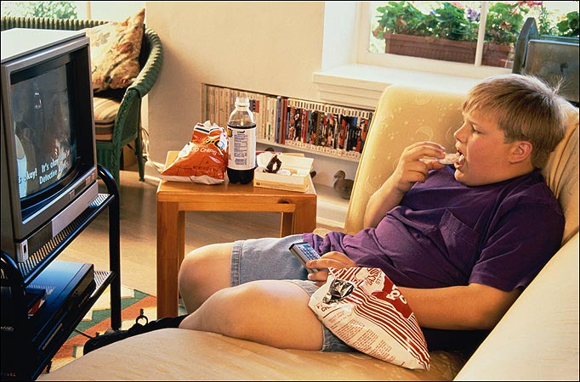
What stages are the following people?

Slide 11
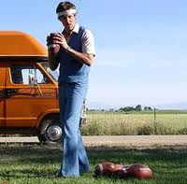
What stages are the following people?

Slide 12
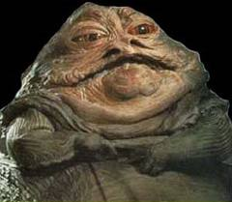
What stages are the following people?

Slide 13
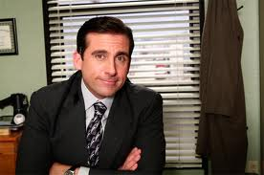
What stages are the following people?

Slide 14
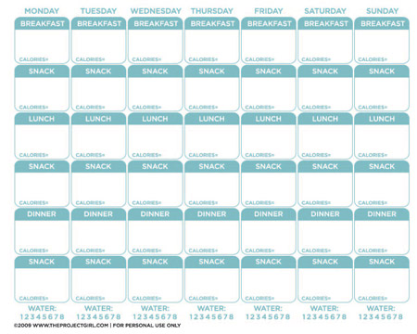
FOOD LOG

Slide 15
Chapter 15

Slide 16
Quackery and Fraud
Quackery:
A method of advertising or selling that uses false claims
Many products sold as sport supplements, or ergogenic aids, are quack products

Slide 17
Quackery and Fraud
8 ways to detect quackery and fraud:
1. Check credentials
2. Be wary of advisors who sell products
3. Check the organizations of the experts you consult
4. Be wary of those who promise immediate results
5. Be suspicious of sales pitches that promise results too good to be true
6. Be cautious about mail order and internet sales
7. Be wary of product claims
8. Be wary of untested products

Slide 18
Diets and Supplements
Diet:
Changing what you eat and how you exercise to be able to lose weight
Fad Diet:
A diet that often promises quick results but is usually nutritionally unbalanced
Food Supplements:
A product intended to add to a person’s nutritional intake

Slide 19
Certified Health Professionals
Health Education Teacher:
Someone who can teach and answer concerns about general health
Dietitian:
Offers advice about diet and nutrition
Nutritionist:
Someone who can recommend diet and nutrition guidelines
Registered Physical Therapist:
Someone who can treat and recommend fitness exercises
Medical Doctor:
Someone who can diagnose and recommend a fitness and diet program

Slide 20
Chapter 18

Slide 21
Fitness Profile
A Breif Summary of the results of your fitness Self Assesmnets
Ex. Fitness Gram
What are we testing? Why is a fitness profile important when planning a program?

Slide 22
Program Planning
Steps to Program Planning
Info
Consider a Variety of Activities
Set Goals
Structure Your Program
Plan and Write it Down
Evaluate Your Program after you have tried it
Why is program planning important

