Slide 1
INTRO TO NUTRITION

Slide 2
Writing Prompt:
Why do you think obesity is on the rise in the United States?

Slide 3
Evaluate how the Food Pyramid/My Plate can enhance proper nutritional choice. --- Analyze and employ healthy food choices
Learning Target

Slide 4
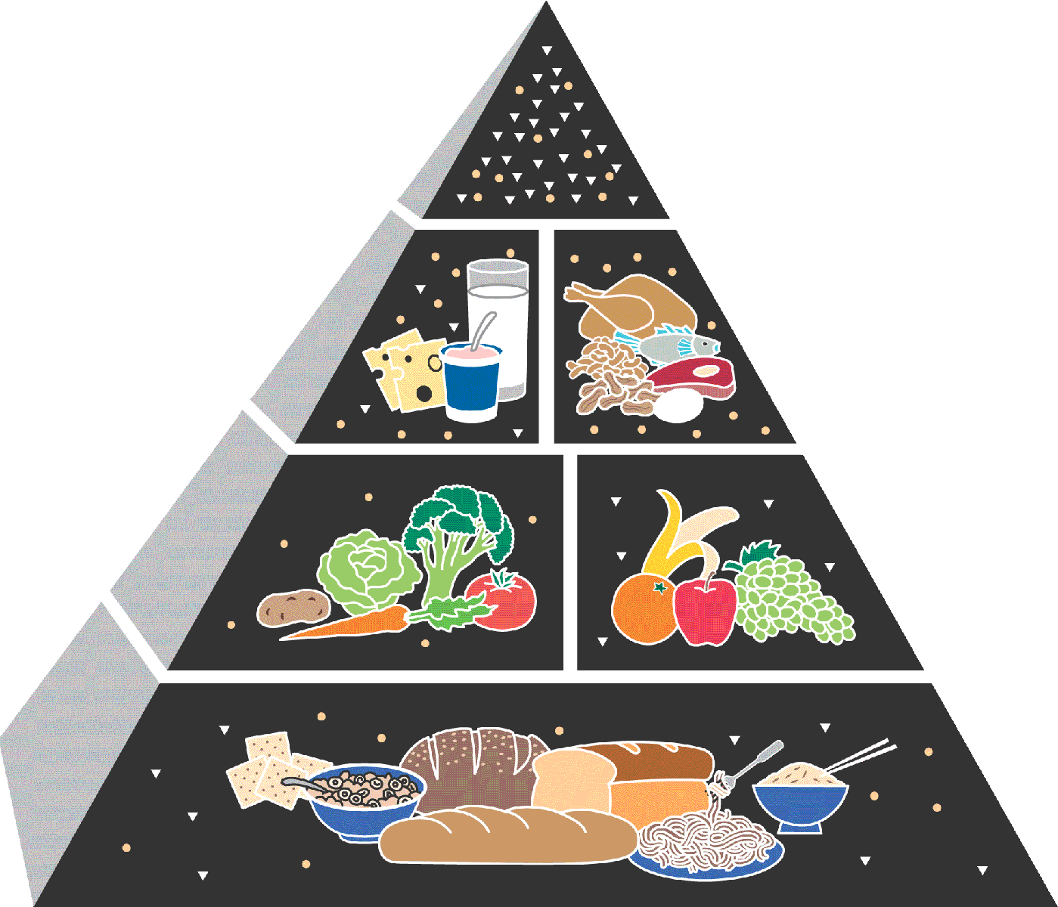
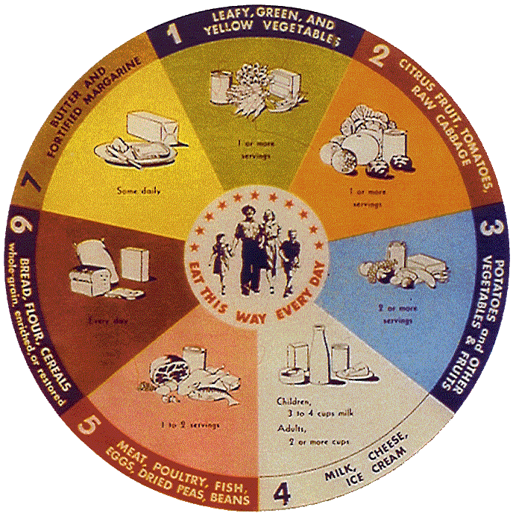
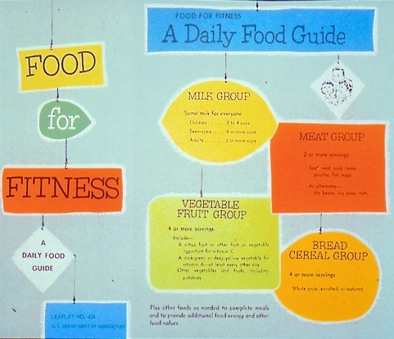
History of USDA’s Food Guidance
Food for Young Children
1992
1916
1940s
1970s
2005
1950s-1960s
Notes:
USDA has had a long history with food guidance dating back into the early 20th century.
Looking back over this history, many different food guides have been used. They represented health and nutrition concerns of the time when they were introduced.
For example,
In the 1940’s the wartime food guide promoted eating foods that provided the vitamins and minerals needed to prevent deficiencies.
In the 1950’s-1960’s the 7 food groups were simplified into a “Food for Fitness” guide, which was commonly called “The Basic Four.”
By the later 1970’s, concerns about dietary excess lead USDA to issue “The Hassle-Free Daily Food Guide,” which included a “caution” group of fats, sweets, and alcohol.
All of these food guides preceded the introduction of the original Food Guide Pyramid in 1992.
NOTE TO PRESENTER: The food guides pictured above are--
1916: Food for Young Children
1940s (1946): National Food Guide (commonly called “The Basic Seven”)
1950s-1960s (1956): Food for Fitness—A Daily Food Guide (commonly called “The Basic Four”)
1970s (1979): Hassle-Free Guide to a Better Diet
1992: Food Guide Pyramid
2005: MyPyramid

Slide 5
Notes:
2011 My plate

Slide 6
My Plate guidelines
Grains: Make at least half your grains whole.
Vegetables: Vary your veggies
Fruit: Focus on fruits
Dairy: Get your calcium-rich foods.
Protein Foods: Go lean with protein.
Notes:
Put Students into groups and rotate through each food group

Slide 7
Dietary Guidelines 2011 Selected Messages for Consumers
Take action on the Dietary Guidelines by making changes in these three areas…
Balancing Calories
Foods to Increase
Foods to Reduce

Slide 8
Dietary Guidelines 2015-2020
Follow a healthy eating pattern across the lifespan.
Focus on variety, nutrient density, and amount.
Limit calories from added sugars and saturated fats and reduce sodium intake.
Shift to healthier food and beverage choices.
Support healthy eating patterns for all.

Slide 9
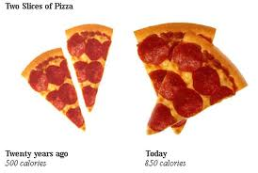
Balancing Calories
Enjoy your food, but eat less.
Avoid oversized portions.
Notes:
http://www.cbsnews.com/news/how-americans-eat-today/

Slide 10
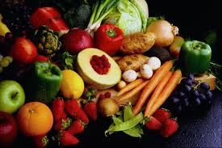
Foods to Increase
Make half your plate fruits and vegetables.
Make at least half your grains whole grains.
Switch to fat-free or low fat (1%) milk.

Slide 11
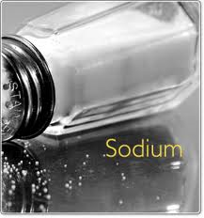
Foods to Reduce
Compare sodium in foods like soup, bread, and frozen meals—and choose the foods with lower numbers.
Drink water instead of sugary drinks.

Slide 12
Carbohydrates
Six Essential Nutrients
Our major source of energy
AKA: Sugars, starches, carbs
Found in grains, sugar, fruits, vegetables
70% of our calories should come from carbohydrates
Notes:
Unhealthy high carbs:
Cereals, crackers, potatoes,
Healthy high carbs: veggies, legumes (beans), whole grains, fruit, nuts, and yogurt.
Simple- sugar such as fructose (fruit) and lactose (milk) Naturally
Complex- are bread, pasta, beans, and root veggies, potatoes

Slide 13
Fat
Energy storage
AKA: oils and lipids
15-25% of our calories should come from fat
Notes:
Most Vegetable oils are healthy
Saturated and unsaturated fatty acids: good and healthy oils, butter, milks
Unsaturated fats- are in palm oils, canola oils and fish- good fats!!!
Trans fatty acids- are the ones in donuts and cookies and fried foods

Slide 14
Protein
Repairs and builds muscle
Found in meat, beans, grains
Complete (animal foods) vs. incomplete (Non-animal based foods)
Notes:
Complete protein- includes all 9 essential amino acids these are the animal foods
Incomplete protein- lacking 1 or more of the 9 essential amino acids- Non animal base foods. Grains, nuts, beans, seeds, peas, and corn

Slide 15
Vitamins and Minerals
Vitamins are organic substances (made by plants or animals). Fat and water soluble.
Minerals are inorganic elements(come from the earth), cannot be created in body.
Both are needed for growth and development.

Slide 16
Water
Water helps the body transport nutrients and flush out waste
Body is 55-78% water depending on body size.
We need about 8 cups of water daily
(LOTS more in hot weather or while exercising)

Slide 17
Fiber
Indigestible plant material
Keeps our digestive system moving
Helps prevent some types of cancer
Only found in WHOLE grains and lentils
Most Americans only get 1/5 of what they need.
Notes:
Barley, wheat, spaghetti, brown rice, oatmeal, fruits have fiber, vegetables
-Tough type of carbohydrate that the body cannot digest.
Eating 20- 35 grams per day. Fruits, veggies, and whole grains.

