Slide 1
Why do people smoke cigarettes even though they know it is bad for them?
Writing Prompt

Slide 2
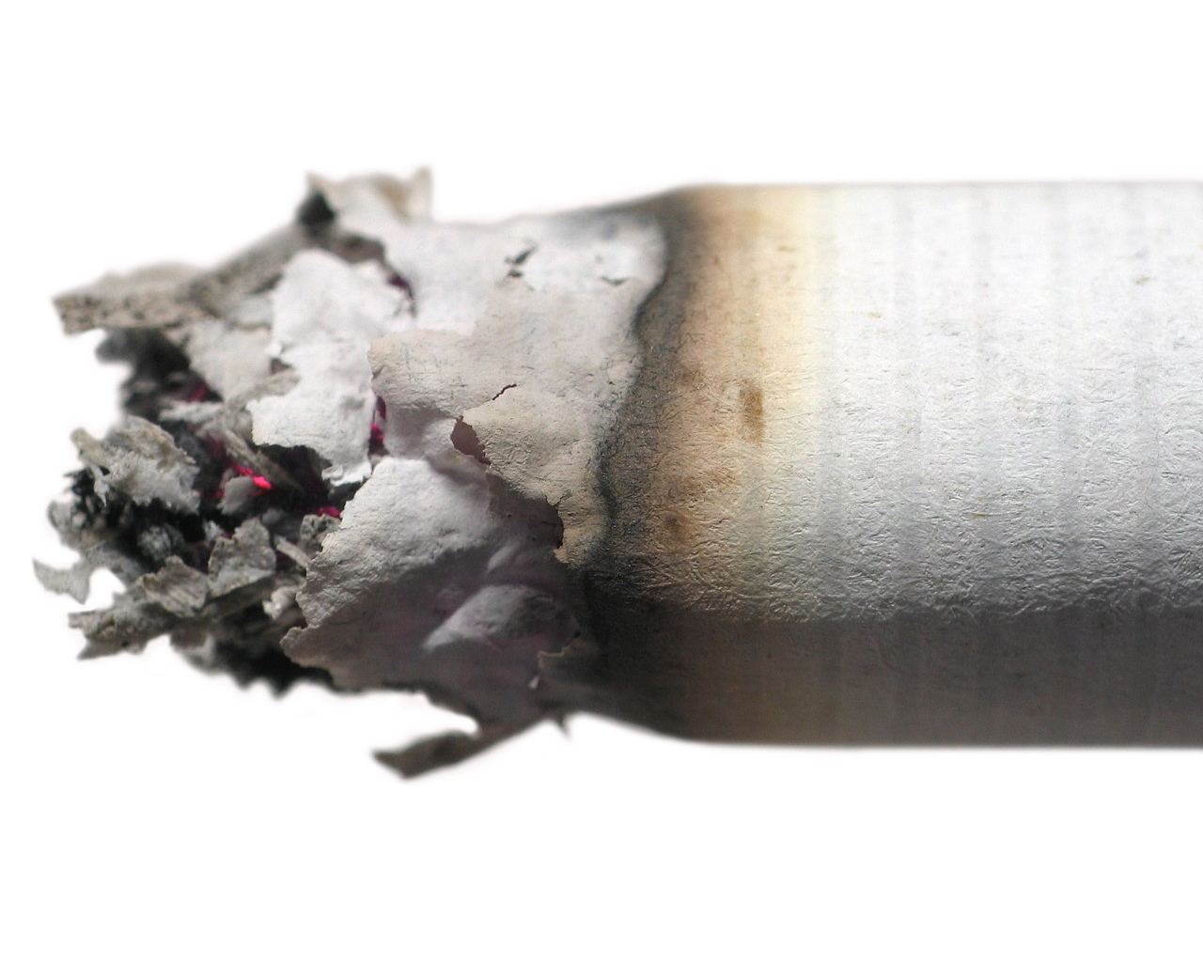
Tobacco

Slide 3
Effects of Nicotine
Causes liver to release glycogen, raising blood sugar level
Inhibits production of urine in kidneys
Stimulates adrenal glands to release adrenaline, causing changes in functioning of heart and other organs.
Accelerates heart rate, elevates blood pressure.
Constricts blood vessels, especially in skin.
Stimulates brain to release chemicals that alter mood.
These are just a few……

Slide 4
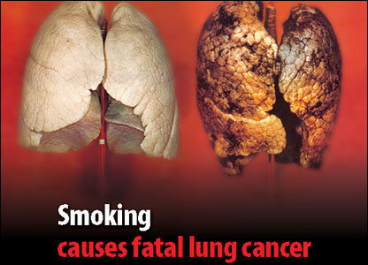
Does anyone not know this?

Slide 5
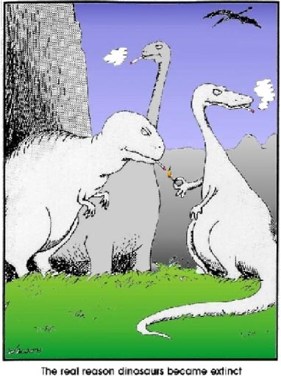

Slide 6
$$$$ Cost of Smoking $$$$
Cigarettes
Lighter/matches
Depreciation of home and vehicles
Increased cost for health insurance, life insurance, home insurance, and vehicle insurance
Difficulty finding a job and apartment
More sick days from work
Higher lifetime medical expenses
Notes:
Tell Story of Scott couldn’t buy car because it had smoke smell in seats.

Slide 7
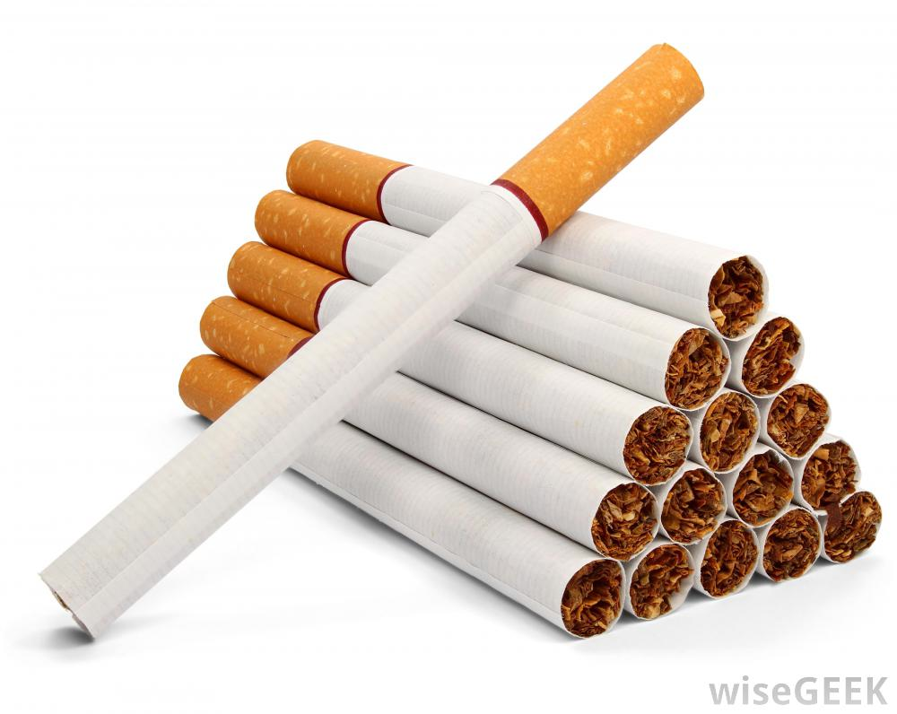
Can anyone guess how many additives are in cigarettes? Ever wonder why cigarette packs don’t list their ingredients?

Slide 8
There are 599 additives to cigarettes
Acetanisole
Acetic Acid
Acetoin
Acetophenone
6-Acetoxydihydrotheaspirane
2-Acetyl-3- Ethylpyrazine
2-Acetyl-5-Methylfuran
Acetylpyrazine
2-Acetylpyridine
3-Acetylpyridine
2-Acetylthiazole
Aconitic Acid
dl-Alanine
Alfalfa Extract
Allspice Extract
Allyl Hexanoate
Allyl Ionone
Almond Bitter Oil
Ambergris Tincture
Ammonia

Slide 9
There are 599 additives to cigarettes
Ammonium Bicarbonate
Ammonium Hydroxide
Ammonium Phosphate
Ammonium Sulfide
Amyl Alcohol
Amyl Butyrate
Amyl Formate
Amyl Octanoate
Alpha-Amylcinnamaldehyde
Amyris Oil
trans-Anethole
Angelica Root Extract
Anise
Anise Star
Anisyl Acetate
Anisyl Alcohol
Anisyl Formate
Anisyl Phenylacetate
Apple Juice Concentrate
Apricot Extract

Slide 10
There are 599 additives to cigarettes
Benzaldehyde
Benzaldehyde Glyceryl
Benzoic Acid
Benzoin Resin
Benzophenone
Benzyl Alcohol
Benzyl Benzoate
Benzyl Butyrate
Benzyl Cinnamate
Benzyl Propionate
Benzyl Salicylate
1-Arginine
Asafetida Fluid Extract
Ascorbic Acid
1-Asparagine Monohydrate
1-Aspartic Acid
Balsam Peru and Oil
Basil Oil
Bay Leaf
Beeswax White
Beet Juice Concentrate

Slide 11
There are 599 additives to cigarettes
Bergamot Oil
Bisabolene
Black Currant
Buds Absolute Borneol
Bornyl Acetate
Buchu Leaf Oil
1,3-Butanediol
2,3-Butanedione
1-Butanol
2-Butanone
Butter
Butyl Acetate
Butyl Butyrate
Butyl Butyryl Lactate
Butyl Isovalerate
Butyl Phenylacetate
Butyl Undecylenate
3-Butylidenephthalide
Butyric Acid
Cadinene

Slide 12
There are 599 additives to cigarettes
Caffeine
Calcium Carbonate
Camphene
Cananga Oil
Capsicum Oleoresin
Caramel Color
Caraway Oil
Carbon Dioxide
Cardamom Oleoresin
Carob Bean and Extract
beta-Carotene
Carrot Oil
Carvacrol
4-Carvomenthenol
1-Carvone
beta-Caryophyllene
beta-Caryophyllene Oxide
Cascarilla Oil
Cassia Bark Oil
Cassie Absolute and Oil

Slide 13
There are 599 additives to cigarettes
Castoreum Extract
Cedar Leaf Oil
Cedarwood Oil
Cedrol
Celery Seed Extract
Cellulose Fiber
Chamomile Flower Oil
Chicory Extract
Chocolate
Cinnamaldehyde
Cinnamic Acid
Cinnamon Leaf Oil
Cinnamyl Acetate
Cinnamyl Alcohol
Cinnamyl Cinnamate
Cinnamyl Isovalerate
Cinnamyl Propionate
Citral
Citric Acid
Citronella Oil

Slide 14
There are 599 additives to cigarettes
dl-Citronellol
Citronellyl Butyrateitronellyl
Civet Absolute
Clary Oil
Clover Tops
Cocoa
Cocoa Shells
Coconut Oil
Coffee
Cognac
Copaiba Oil
Coriander Extract and Oil
Corn Oil
Corn Silk
Costus Root Oil
Cubeb Oil
Cuminaldehydepara
1-Cysteine

Slide 15
There are 599 additives to cigarettes
Dandelion Root Solid Extract
Davana Oil
4-trans-Decadienal
Delta-Decalactone
Gamma-decalactone
Decanal
Decanoic Acid
1-Decanol
2-Decenal
Dehydromenthofurolactone
Diethyl Malonate
Diethyl Sebacate
2,3-Diethylpyrazine
Dihydro Anethole
5,7-Dihydro-2-
Dill Seed Oil and Extract
meta-Dimethoxybenzene
Dimethoxybenzene
2,6-Dimethoxyphenol
Dimethyl Succinate

Slide 16
There are 599 additives to cigarettes
3,4-Dimethyl
3,5- Dimethyl
3,7-Dimethyl
4,5-Dimethyl-3-Hydroxy-2,5-
Dihydrofuran-2-One
6,10-Dimethyl
3,7-Dimethyl-6-Octenoic Acid
2,4 Dimethylacetophenone
para-Dimethylbenzyl Alcohol
alpha-Dimethylphenethyl
alpha Dimethylphenethyl
2,3-Dimethylpyrazine
2,5-Dimethylpyrazine
2,6-Dimethylpyrazine
Dimethyltetrahydro…
delta-Dodecalactone
gamma-Dodecalactone
para-Ethoxybenzaldehyde
Ethyl 10-Undecenoate
Ethyl 2-Methylbutyrate
Ethyl Acetate

Slide 17
There are 599 additives to cigarettes
Ethyl Acetoacetate
Ethyl Alcohol
Ethyl Benzoate
Ethyl Butyrate
Ethyl Cinnamate
Ethyl Decanoate
Ethyl Fenchol
Ethyl Furoate
Ethyl Heptanoate
Ethyl Hexanoate
Ethyl Isovalerate
Ethyl Lactate
Ethyl Laurate
Ethyl Levulinate
Ethyl Maltol
Ethyl Methyl Phenylglyci…
Ethyl Myristate
Ethyl Nonanoate
Ethyl Octadecanoate
Ethyl Octanoate

Slide 18
There are 599 additives to cigarettes
Ethyl Oleate
Ethyl Palmitate
Ethyl Phenylacetate
Ethyl Propionate
Ethyl Salicylate
Ethyl trans-2-Butenoate
Ethyl Valerate
Ethyl Vanillin
2-Ethyl (or Methyl)
2-Ethyl-1-Hexanol
3-Ethyl -2 -Hydroxy
2-Ethyl-3
5-Ethyl-3-Hydroxy
2-Ethyl-3-Methylpyrazine
4-Ethylbenzaldehyde
4-Ethylguaiacol
para-Ethylphenol
3-Ethylpyridine
Eucalyptol
Farnesol
D-Fenchone

Slide 19
There are 599 additives to cigarettes
Fennel Sweet Oil
Fenugreek, Extract, Resin, and Absolute
Fig Juice Concentrate
Food Starch Modified
Furfuryl Mercaptan
4-(2-Furyl)-3-Buten-2-One
Galbanum Oil
Genet Absolute
Gentian Root Extract
Geraniol
Geranium Rose Oil
Geranyl Acetate
Geranyl Butyrate
Geranyl Formate
Geranyl Isovalerate
Geranyl Phenylacetate
Ginger Oil and Oleoresin
1-Glutamic Acid
1-Glutamine
Glycerol

Slide 20
There are 599 additives to cigarettes
Glycyrrhizin Ammoniated
Grape Juice Concentrate
Guaiac Wood Oil
Guaiacol
Guar Gum
2,4-Heptadienal
gamma-Heptalactone
Heptanoic Acid
2-Heptanone
3-Hepten-2-One
2-Hepten-4-One
4-Heptenaltrans -2-
Heptenal
Heptyl Acetateomega-6-
Hexadecenlactone
gamma-Hexalactone
Hexanal
Hexanoic Acid
2-Hexen-1-Ol
3-Hexen-1-Ol

Slide 21
There are 599 additives to cigarettes
cis-3-Hexen-1-Y
l Acetate
2-Hexenal
3-Hexenoic Acid
trans-2-Hexenoic Acid
cis-3-Hexenyl Formate
Hexyl 2-Methylbutyrate
Hexyl Acetate
Hexyl Alcohol
Hexyl Phenylacetate
1-Histidine
Honey
Hops Oil
Hydrolyzed Milk Solids
Hydrolyzed Plant Proteins
5-Hydroxy-2,4-Decad
4-Hydroxy-2,5-Dimethyl
2-Hydroxy-3,5,5-Trimethyl
4-Hydroxy -3-Pentenoic Acid Lactone
2-Hydroxy-4-Methyl
4-Hydroxybutanoic Acid

Slide 22
There are 599 additives to cigarettes
Hydroxycitronellal
6-Hydroxydihydrotheaspirane
4-(para-Hydroxyphenyl)
Hyssop Oil
Immortelle
alpha-Ionone
beta-Ionone
alpha-Irone
Isoamyl Acetate
Isoamyl Benzoate
Isoamyl Butyrate
Isoamyl Cinnamate
Isoamyl Formate
Isoamyl Hexanoate
Isoamyl Isovalerate
Isoamyl Octanoate
Isoamyl Phenylacetate
Isobornyl Acetate
Isobutyl Acetate
Isobutyl Alcohol

Slide 23
There are 599 additives to cigarettes
Isobutyl Cinnamate
Isobutyl Phenylacetate
Isobutyl Salicylate
Isobutyl Methoxypyrazine
Isobuty
lphenethyl Alcohol
IsobutyraldehydeIsobutyric
Isoleucine
alpha-Isomethylionone
2-Isopropylphenol
Isovaleric Acid
Jasmine Absolute
Kola Nut Extract
Labdanum Absolute
Lactic Acid
Lauric Acid
Lauric Aldehyde
Lavandin Oil
Lavender Oil
Lemon Oil and Extract

Slide 24
There are 599 additives to cigarettes
Lemongrass Oil
1-Leucine
Levulinic Acid
Licorice Root
Lime Oil
Linalool
Linalool Oxide
Linalyl Acetate
Linden Flowers
Lovage Oil And Extract
1-Lysine]Mace Powder
Magnesium Carbonate
Malic Acid
Malt
Malt Extract
Maltodextrin
Maltol
Maltyl Isobutyrate
Mandarin Oil
Maple Syrup

Slide 25
There are 599 additives to cigarettes
Mate Leaf, Absolute and Oil
para-Mentha-8-Thiol-3-One
Menthol
Menthone
Menthyl Acetate
dl-Methionine
Methoprene
2-Methoxy-4-Methylphenol
2-Methoxy-4-Vinylphenol
para-Methoxybenzaldehyde
1-(para-Methoxyphenyl)
4-(para-Methoxyphenyl)
1-(para-Methoxyphenyl)
Methoxypyrazine
Methyl 2-Furoate
Methyl 2-Octynoate
Methyl 2-Pyrrolyl Ketone
Methyl Anisate
Methyl Anthranilate
Methyl Benzoate

Slide 26
There are 599 additives to cigarettes
Methyl Cinnamate
Methyl Dihydrojasmonate
Methyl Ester of Rosin
Methyl Isovalerate
Methyl Linoleate (48%)
Methyl Linolenate (52%)
Methyl Naphthyl Ketone
Methyl Nicotinate
Methyl Phenylacetate
Methyl Salicylate
Methyl Sulfide
3-Methyl-1-Cyclopentade
4-Methyl-1-Phenyl-Pentan
5-Methyl-2-Phenyl-2-Hexe
Methyl Thiophenecarbox
6-Methyl-3,-5-Heptadien-2
2-Methyl-3-
5-Methyl-3-Hexen-2
Methoxy-4-Isopropylbenzene
4-Methyl-3-Pentene-2-One

Slide 27
There are 599 additives to cigarettes
2-Methylbutyraldehyde
3-Methylbutyraldehyde
2-Methylbutyric Acid
Methylcinnamaldehyde
Methylcyclopentenolone
2-Methylheptanoic Acid
2-Methylhexanoic Acid
3-Methylpentanoic Acid
4-Methylpentanoic Acid
2-Methylpyrazine
5-Methylquinoxaline
2-Methyl-4-Phenylbutyraldehyde
6-Methyl-5-Hepten-2-One
4-Methyl-5-Thiazoleethanol
4-Methyl-5-Vinylthiazole
Methyl-alpha-Ionone
Methyl-trans-2-Butenoic Acid
4-Methylacetophenone
para-Methylanisole
alpha-Methylbenzyl Acetate
alpha-Methylbenzyl Alcohol

Slide 28
There are 599 additives to cigarettes
Myristic Acid
Myrrh Oil
beta-Napthyl Ethyl Ether
Nerol
Neroli Bigarde Oil
Nerolidol
Nona-2-trans,6-cis-Dienal
6-Nonadien-1-Ol
gamma-Nonalactone
Nonanal
2-Methyltetrahydrofuran-3-
3-Methylthiopropionaldehyde
Methyl 3-
Methylthiopropionate
2-Methylvaleric Acid
Mimosa Absolute and Extract
Molasses Extract and Tincture
Mountain Maple Solid Extract
Mullein Flowers
Myristaldehyde

Slide 29
There are 599 additives to cigarettes
Nonanoic Acid
Nonanonetrans
2-Nonenal
Nonyl Acetate
Nutmeg Powder and Oil
Oak Chips Extract and Oil
Oak Moss Absolute
Octadecatrienoic Acid (52%)
Delta-Octalactone
gamma-Octalactone
Octanal
Octanoic Acid
1-Octanol
2-Octanone
3-Octen-2-One
1-Octen-3-Ol
1-Octen-3-Yl Acetate
2-Octenal
Octyl Isobutyrate
Oleic Acid

Slide 30
There are 599 additives to cigarettes
Olibanum Oil
Opoponax Oil And Gum
Orange Blossoms
Orange Oil and Extract
Origanum Oil
Orris Concrete Oil
Palmarosa Oil
Palmitic Acid
Parsley Seed Oil
Patchouli Oil
omega-Pentadecalactone
2,3-Pentanedione
2-Pentanone
4-Pentenoic Acid
2-Pentylpyridine
Pepper Oil
Peppermint Oil
Peruvian Oil
Petitgrain Absolute
alpha-Phellandrene

Slide 31
There are 599 additives to cigarettes
2-Phenenthyl Acetate
Phenenthyl Alcohol
Phenethyl Butyrate
Phenethyl Cinnamate
Phenethyl Isobutyrate
Phenethyl Isovalerate
Phenethyl Phenylacetate
Phenethyl Salicylate
1-Phenyl-1-Propanol
3-Phenyl-1-Propanol
2-Phenyl-2-Butenal
4-Phenyl-3-Buten-2-Ol
4-Phenyl-3-Buten-2-One
Phenylacetaldehyde
Phenylacetic Acid
1-Phenylalanine
3-Phenylpropionaldehyde
3-Phenylpropionic Acid
3-Phenylpropyl Acetate
Phenylpropyl Cinnamate

Slide 32
There are 599 additives to cigarettes
2-Tetrahydrofuran
Phosphoric Acid
Pimenta Leaf Oil
Pine Needle Oil, Pine Oil, Scotch
Pineapple Juice Concentrate
alpha-Pinene, beta-Pinene
D-Piperitone
Piperonal
Pipsissewa Leaf Extract
Plum Juice
Potassium Sorbate
1-Proline
Propenylguaethol
Propionic Acid
Propyl Acetate
Propyl para-Hydroxybenzoate
Propylene Glycol
3-Propylidenephthalide
Prune Juice
Pyridine

Slide 33
There are 599 additives to cigarettes
Pyroligneous Acid
Pyrrole
Pyruvic Acid
Raisin Juice Concentrate
Rhodinol
Rose Absolute and Oil
Rosemary Oil
Rum
Rum Ether
Rye Extract
Sage, Sage Oil, and Sage Oleoresin
Salicylaldehyde
Sandalwood Oil, Yellow
Sclareolide
Skatole
Smoke Flavor
Snakeroot Oil
Sodium Acetate
Sodium Benzoate
Sodium Bicarbonate

Slide 34
There are 599 additives to cigarettes
Sodium Carbonate
Sodium Chloride
Sodium Citrate
Sodium Hydroxide
Solanone
Spearmint Oil
Styrax Extract, Gum and Oil
Sucrose Octaacetate
Sugar Alcohols
Sugars
Tagetes Oil
Tannic Acid
Tartaric Acid
Tea Leaf and Absolute
alpha-Terpineol
TerpinoleneTerpinyl Acetate
Tetrahydroquinoxaline
Tetramethyl-13-Oxatricyclo
Tridecane
Tetramethylethyl

Slide 35
There are 599 additives to cigarettes
para-Tolyl Methylbutyrate
para-Tolyl Acetaldehyde
para-Tolyl Acetate
para-Tolyl Isobutyrate
para-Tolyl Phenylacetate
Triacetin
2-Tridecanone
2-Tridecenal
Triethyl Citrate
Trimethyl -1-Hexanol
Tetramethylpyrazine
Thiamine Hydrochloride
Thiazole1-Threonine
Thyme Oil, White and Red
Thymol
Tobacco Extracts
Tochopherols (mixed)
Tolu Balsam Gum and Extract
Tolualdehydes

Slide 36
There are 599 additives to cigarettes
alpha-Trimethylbenzyl Alcohol
Trimethylcyclohex-1-Enyl)
Trimethylcyclohex-2-Ene-1,4
Trimethylcyclohexa-1,3-Dienyl
Trimethylcyclohexa
2,2,6-Trimethylcyclohexanone
2,3,5-Trimethylpyrazine
1-Tyrosine
delta-Undercalactone
gamma-Undecalactone
Undecanal
2-Undecanone, 10-
Undecenal
Urea
Valencene
Valeraldehyde
Valerian Root Extract
Valeric Acid
gamma-Valerolactone
Valine

Slide 37
There are 599 additives to cigarettes
Vanilla Extract And Oleoresin
Vanillin
Veratraldehyde
Vetiver Oil
Vinegar
Violet Leaf Absolute
Walnut Hull Extract
Water
Wheat Extract And Flour
Wild Cherry Bark Extract
Wine and Wine Sherry
Xanthan Gum
3,4-Xylenol
Yeast

Slide 38
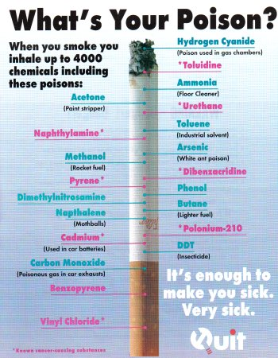
These 599 additives combine to create over 4,000 chemicals when the cigarette is burned!

Slide 39
Some Other Effects of Tobacco…

Slide 40
Causes Emphysema and other diseases
Straw Demonstration
Notes:
Take students to do straw activity

Slide 41
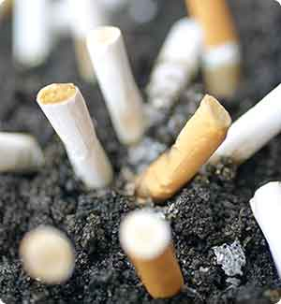
Smell

Slide 42
Dental Problems

Slide 43
Wrinkly Face

Slide 44
Dingy Hair

Slide 45
Freedom

Slide 46
Decreased Lung Capacity

Slide 47
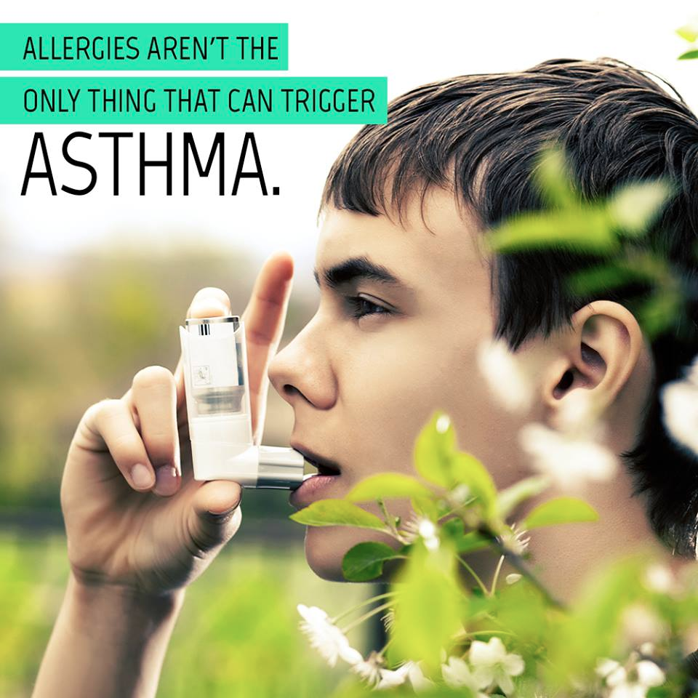
Asthma

Slide 48
Lung Infections

Slide 49
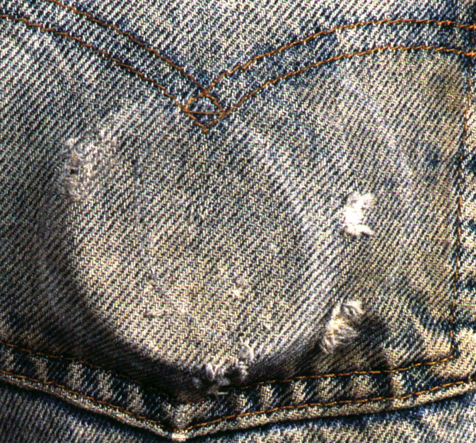
Smoke-less tobacco causes cancer VERY quickly

Slide 50
Impotence (weak)
Notes:
Inability or diffculty to have children

Slide 51
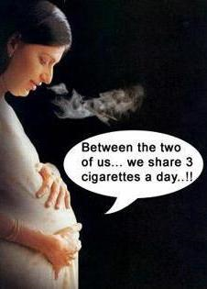
Danger to unborn babies

Slide 52
Danger to Others

Slide 53
How to Quit Smoking
Cold turkey?
Nicotine replacement therapy- includes: gum, patches, inhalers, sprays, lozenges
Natural supplements?
Hypnotism?
Behavioral Therapy
Medicine
Combo Treatments
What else?

Slide 54
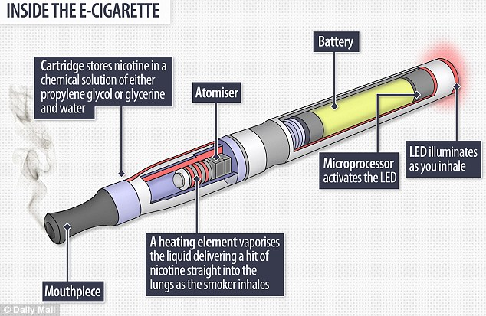
E-Cigarettes
Notes:
-Ecigs, vapes, and mods

Slide 55
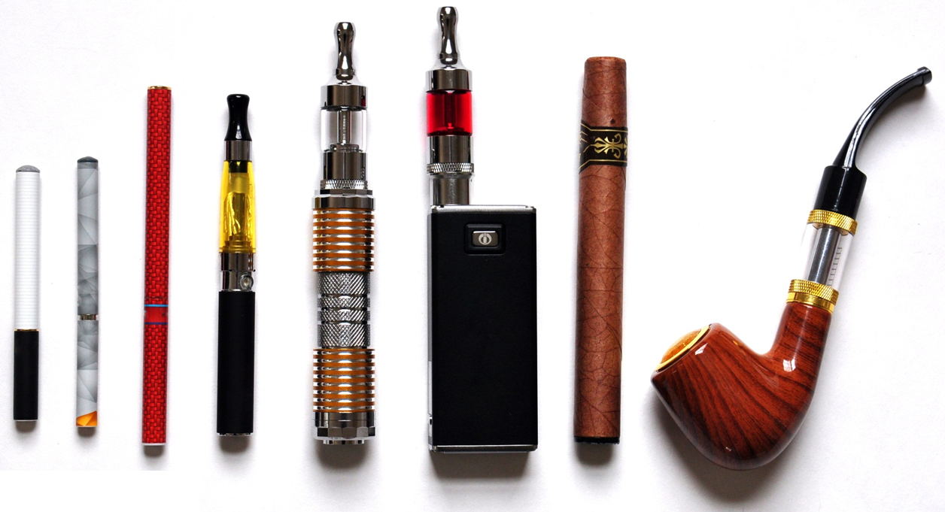
E-Cigarettes

Slide 56
What are E- Cigarettes? Are they better for you than regular cigarettes?
Writing Prompt:
Notes:
Turns kids into addicts
-Just as addictive drug
-can still cause cancer
-Just as bad as cigarettes

Slide 57
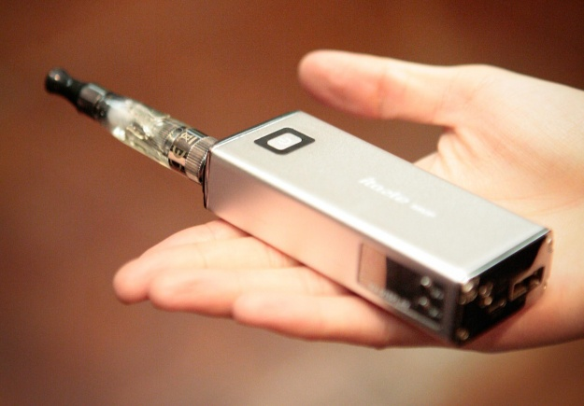
Invented in 1960’s
More than 250 brands/flavors available including: watermelon, bubble gum, coffee
Battery operated nicotine inhalers
Heating element boils a liquid until it becomes a vapor that you inhale
Creates the same amount of vapor no matter how hard you puff or until the battery runs down
Notes:
70% of users are dual users
Diacetyl- In microwaved popcorn- Popcorn lung
-Not effective to help people quit smoking cuz they still want the buzz.

Slide 58
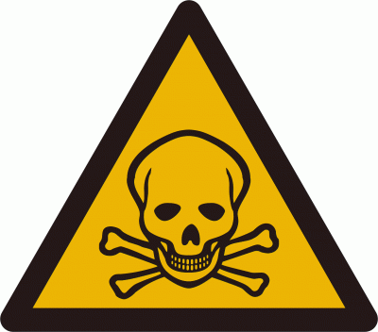
Safety Concerns
E-cigarettes were regulated May 2016 and now under same regulations at cigarettes
Still contains addictive substances
Can lead to artery damage
Decreased lung function
Gateway to smoking and other drugs
Exploding E- cigs
Notes:
Buyers used to be teens
Can’t smoke in buildings
E cigs Smoking went from 4.7% to 17.2% of seniors in U.S. in jumped from 2011 to 2014

