Slide 1
Substance Abuse
Advertizing in the Media

Slide 2
Do you believe that people are affected by the media?

Slide 3
Media Influence
There are nearly 115 million TV homes in the US, each averaging 2.86 TV sets, according to a new Nielsen study. That computes to nearly 329 million TV sets -- more than the entire US population, estimated at 307 million by the US Census Bureau.

Slide 4
Media Exposure
Age and daily media exposure:
8 – 10 year olds 7:51 hours
11 – 14 year olds 11:53 hours
15 – 18 year olds 11:23 hours

Slide 5
Key Questions for Media Literacy
1. Who is the “target audience”? What is their age, ethnicity, class, profession, interests, etc.?
2. What is the “text” of the message? (What we actually see).
3. What is the “subtext” of the message? (What do you think is the hidden or unstated meaning?)
4. What “tools of persuasion” are used?
5. What part of the story is not being told?

Slide 6
Tools of Persuasion
If we can spot the techniques being used, we’re less likely to be persuaded, and more likely to think for ourselves.
Humor
Sex
Friends
Family
Fun
Nature
Macho
Cartoon
Celebrity
Wealth

Slide 7
SEX APPEAL
You will find love and romance by using the product. Ads with thin, sexy, pretty women, and/or strong, handsome, ruggen men suggest you can be that way too!

Slide 8
Bandwagon
If you use this product you can have fun too! Anyone who is anyone is buying this product. “Everyone is doing it!!!”

Slide 9
Snob Appeal
Only rich and sophisticated people use this product. If you use this product you will be rich and sophisticated too.

Slide 10
Nostalgia Appeal
Plain people, back-to-nature, back in the good-old-days, or just like home. Ads that create a feeling of comfort.

Slide 11
Testimonial
An ad showing an important, well-known or famous person testifying that they use the product and so should you!!!

Slide 12
Symbol
A symbol attached to a product, causes you to remember the product whenever you see its symbol.

Slide 13
Health Appeal
This product is good for your health!

Slide 14
HUMOR APPEAL!
Laughing creates a positive feeling and image for the product.

Slide 15
Comparison Appeal
This product is better for you than all the rest.

Slide 16
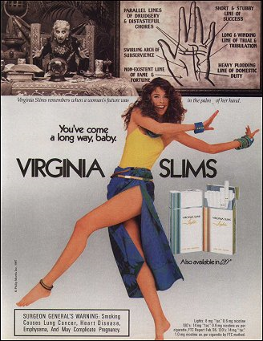
THE FACTS
After the Joe Camel character was introduced, RJ Reynold’s share of the youth market jumped from .5% to 32.8%, while its share of the adult market didn’t change at all.
Following the introduction of Virginia Slims, smoking among young girls more than doubled. Using computer technology, the advertised bodies of young women in their ads are elongated and made to appear even thinner.

Slide 17
THE FACTS
Tobacco companies spend $6 billions each year nationally on advertising.
Why Advertise?

Slide 18
THE FACTS
Every day tobacco companies lose almost 5,000 customers! (1500 die and 3500 quit). The reason they target teens is because they need to replace those customers. Teens are 3X more sensitive to advertising than adults.
Teenage Smoker = Life-Long Customer
One study showed that only 5% of teens said they would still be smoking in five years. But seven years later, 75% were still smoking.

Slide 19
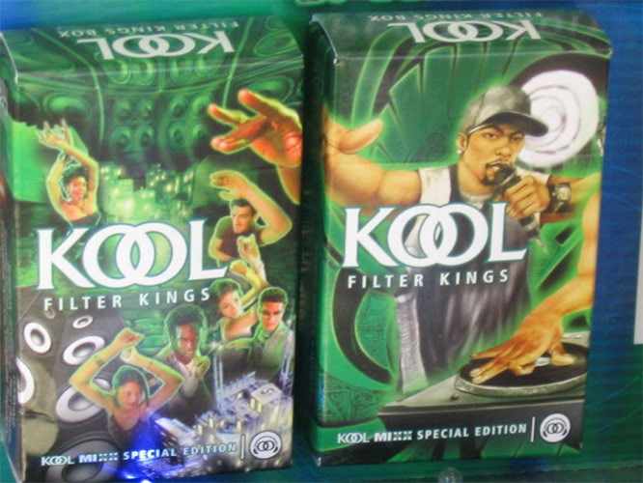
Analyzing Tobacco and Alcohol Advertisements. Practice as a class by using questions in packet to analyze this ad.

Slide 21
Analyze the below ad by using your notes under “Analyzing Tobacco and Alochol Advertisments”

