Slide 1
Adoption
UAC (UTAH ADOPTION COUNCIL)
Notes:
To presenters: Please quickly introduce yourself and your connection to adoption.
Example: “My name is Sally Smith and I am a birth mom. I placed my child for adoption 3 years ago. Today I’m representing the Utah Adoption Council an organization that support and promote adoption. Our goal is to share our experiences about adoption and to educate others on the positive impact adoption can have.”

Slide 2
Unplanned Pregnancy… What are your options?
Parent
Adoption
Abortion
Miscarriage
1%
26%
15%
58%
Notes:
Ask the students “What if you or your girlfriend/partner found yourself experiencing an unplanned pregnancy? What would your options be?” Allow students to brainstorm. After all options have been listed show percentages and ask students which ones match up. Afterwards show matched statistics.
15% result in miscarriage
58% choose to parent (Ask students to imagine how different their life would be if they were parenting a child at that time in their life. What would their child’s life look like? How would it affect their other relationships? Their plans for the future?
Only 20% of teen births occurred within marriage.
One-third of teenage marriages end in divorce within 5 years, and almost half dissolve within 10 years.
Research has shown that childbearing outside of marriage is associated with a decreased likelihood of ever marrying and an increased risk of divorce among those who eventually do.
1% choose adoption
26% choose abortion
It is shocking that the adoption numbers are so low. Part of that is that adoption is not something that is understood or talked about. We are here today to educate on the realities of adoption and share our own experiences of what a positive choice (made by loving and courageous birth parents) adoption can be.
Reference:
Fast Facts: Teen Pregnancy in the United States. The National Campaign to Prevent Teen and Unplanned Pregnancy, 2014. PDF. 7 December 2014.
Science Says: The Relationship between Teenage Motherhood and Marriage. The National Campaign to Prevent Teen and Unplanned Pregnancy, September 2004. PDF. 12 January 2015.

Slide 3
Adoption Terms
Placed her child for adoption
To parent
Birth Parent, biological parent
Parent
Gave up child for adoption
To keep
Real parent; natural parent
Adoptive parent
Preferred Language
Negative Language

Slide 4
Why choose adoption?
Birth parents are trying to provide the best life for their child.
Notes:
(If birth parent presenters are available be sure to ask for their experiences with this.)
Point out the myth that birth parents place their children because they are lazy, selfish or irresponsible. Their choice is one of love and concern for their child.
Common desires for their child include: financial stability, two-parent households, stable home life, education, age/maturity of parents, etc.
Placing a baby for adoption isn’t one decision, but rather a series of decisions made over time by an expectant mother. It involves weighing a number of difficult issues that have both immediate and long-term consequences. At the end of the day, it involves putting the interests of the expectant mother’s child before her own.
Reference:
Center for Disease Control and Prevention. (April 21, 2011). About Teen Pregnancy. Center for Disease Control and Prevention. Retrieved on August 3, 2011 from http://www.cdc.gov/TeenPregnancy/AboutTeenPreg.htm.
National Council for Adoption. (2011). Adoption Factbook V: The most comprehensive source for adoption statistics nationwide. Baltimore: National Council for Adoption.
Smart, Tiffany. “The Decision That Wasn’t Made Lightly: Why I Chose Adoption.” adoption.com. n.p. 23 July 2014. Web. 8 February 2015. <http://adoption.com/decision-wasnt-made-lightly/>
Photo credit: Terra Cooper Photography

Slide 5
Birth Parents:
Myths vs. Reality
Notes:
Read each of the following and ask students whether they think it is a myth or a reality about birth parents (Hint: they are all myths). You can also ask students what they know or think they know about birth parents and see how it stacks up as a myth or reality. If birth parent presenters are available be sure to ask them to weigh in on these and other misconceptions people have about them and how those make them feel.
Myth: Birth parents don’t love or want their children.
Reality: Placing a child for adoption is the ultimate act of love for a mother. It shows that she wants to give the child a better life than she is equipped to give.
Myth: Birth moms are frequently teen moms.
Reality: Expectant mothers come from a variety of backgrounds, some are in their 20s or older and many already have a child they are raising.
Myth: Birth parents would have been unsuitable parents.
Reality: Simply deciding to place a child for adoption is a mark of a great mother (parent) looking to give her child the best life possible.
Myth: Adoption is the easy way out for birth parents.
Reality: The decision to place a child for adoption is not an easy one to make and can be very emotional for both birth parents.
Myth: Birth parents move on and forget about their children after the adoption.
Reality: Most birth mothers will think of their placed child often, if not daily, and today many birth parents maintain contact with the child and his or her adoptive family long after placement.
Myth: Birth parents can someday come back and reclaim their child.
Reality: Adoption is a permanent choice and birth parents understand that. They want a stable and loving forever family for their child. It is not a decision that is taken lightly.
Reference:
Adoption 101: Birth Mom Myths and Realities [Infographic]. 2014. American Adoptions. Web. 12 January 2015. <http://blog.americanadoptions.com/birth-mom-myths-realities/>

Slide 6
The Facts: Teen Parents
Notes:
Birth parents are looking to provide the best life possible for their children. Make it clear that by sharing these numbers we are not trying to imply that one choice (to parent or place) is better than another. It is very possible to be a successful teen parent. However, there are serious challenges. The knowledge of these challenges is what leads many birth parents to choose adoption, to provide the best life possible for their child.
Additional facts to share:
Children of teen parents are more likely too…
Live in poverty (80% of young teenage moms end up in poverty and on welfare)
Have lower school achievement
Drop out of high school
Have more health problems
Have trouble with the law during adolescence (The sons of young teenage moms are 2.7 times more likely to end up in prison than sons born to girls who did not bear children until they were at least 20.)
Face unemployment as adults
Become teen parents themselves (Daughters of teen mothers are also 22% more likely to become teen mothers)
Reference:
National Council for Adoption. (2011). Adoption Factbook V: The most comprehensive source for adoption statistics nationwide. Baltimore: National Council for Adoption.
Johnson, Ryan. “The Reality of Being a Teen Mom (Infographic).” TLC Parentables. 28 June 2011. Web. 7 Dec. 2014. <http://parentables.howstuffworks.com/family-matters/reality-being-teen-mom.html>

Slide 7
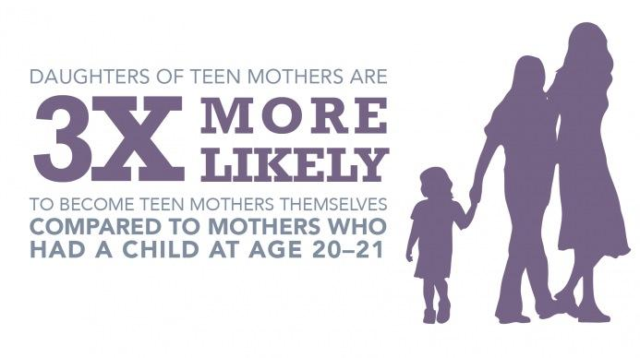
Notes:
Reference:
Johnson, Ryan. “The Reality of Being a Teen Mom (Infographic).” TLC Parentables. 28 June 2011. Web. 7 Dec. 2014. <http://parentables.howstuffworks.com/family-matters/reality-being-teen-mom.html>
“Why It Matters. Making the Case: For Wanted and Welcomed Pregnancy.” The National Campaign to Prevent Teen and Unplanned Pregnancy. n.d. Web. 6 March 2015. <http://thenationalcampaign.org/why-it-matters>

Slide 8
What about the children who are adopted?
Children who are adopted are more likely to:
Have parents that are married and stay married
More likely to have parents with college degrees
Have a greater range of experiences and opportunities (more family stability, better health care, and access to higher education).
Less likely to take part in high risk behaviors (alcohol use, depression, committing crimes etc.)
Notes:
Reference:
Center for Disease Control and Prevention. (April 21, 2011). About Teen Pregnancy. Center for Disease Control and Prevention. Retrieved on August 3, 2011 from http://www.cdc.gov/TeenPregnancy/AboutTeenPreg.htm.
National Council for Adoption. (2011). Adoption Factbook V: The most comprehensive source for adoption statistics nationwide. Baltimore: National Council for Adoption.

Slide 9
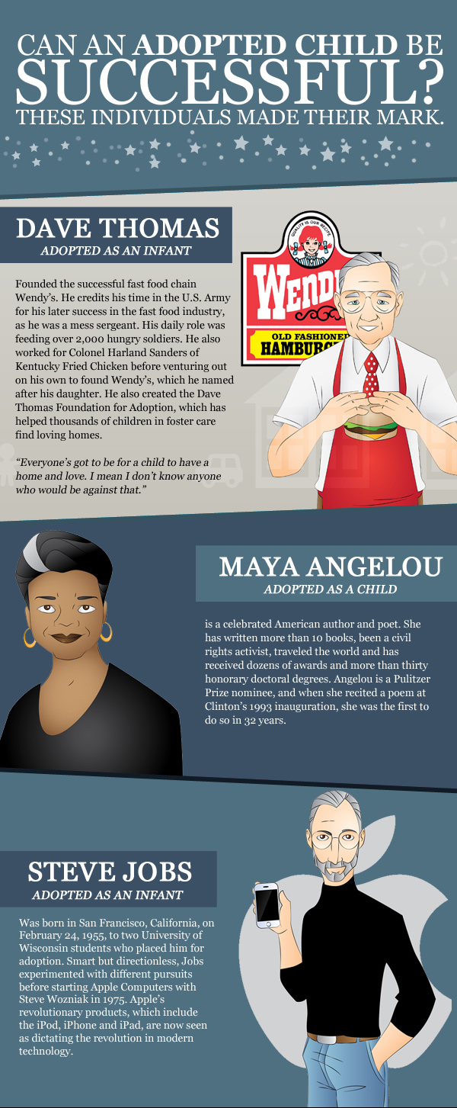
Notes:
Can an adopted child be successful? Of course!!
Some famous adoptees:
Dave Thomas (Founder of Wendy’s)
Maya Angelou (Celebrated author and poet)
Steve Jobs (Founder of Apple)
Dante Culpepper (NFL player with the Vikings)
Faith Hill & Tim McGraw (Country Music Artists)
Nelso Mandela (Nobel Peace Prize Winner)
Nancy Reagan (Former First Lady)
Bill Clinton (42nd President of the United States)
Eleanor Roosevelt (Former First Lady)
Clark Kent
Some other famous adoptees not shown:
John Lennon (Musician)
Kristen Chenoweth (Singer & Actress)
Babe Ruth (Baseball Player)
Michael Bay (Movie Director)
Jamie Foxx (Actor)
Nicole Richie (Actress/Reality Star)
And many, many more…
Reference:
Celebrity Adoption [Infographic]. 2014. American Adoptions. Web. 9 Dec. 2014. <http://blog.americanadoptions.com/famous-adoptees-infographic/>

Slide 10
Types of Adoption
Open
Most common type of adoption today.
The birth parents and adoptive family speak prior to and even after the child is born.
Can have varying degrees of openness/contact after placement.
Common for the adoptive family to mail pictures and letters to the birth parents and even have visits.
Closed
Neither the adoptive or birth parents know each other, nor do they ever meet.
The child will not know who their birth parents are, especially before turning 18.
Before the 1990’s almost all adoptions were closed.
Notes:
When making an adoption plan expectant parents can CHOOSE and CREATE the openness plan that works for them and the adoptive family they choose, and that adoption professionals can assist them in building and managing that relationship.
Expectant parents also need to understand that not all states have enforceable post-adoption contracts.
Also, expectant parents can still choose the adoptive family in a closed adoption. Just will not likely meet and will not exchange information or have contact after the adoption.

Slide 11
What most adoptions look like today…
Notes:
Reference:
Lowry, Rachel. “A heart big enough for two: Navigating an open adoption.” Deseret News 29 July 2012.

Slide 12
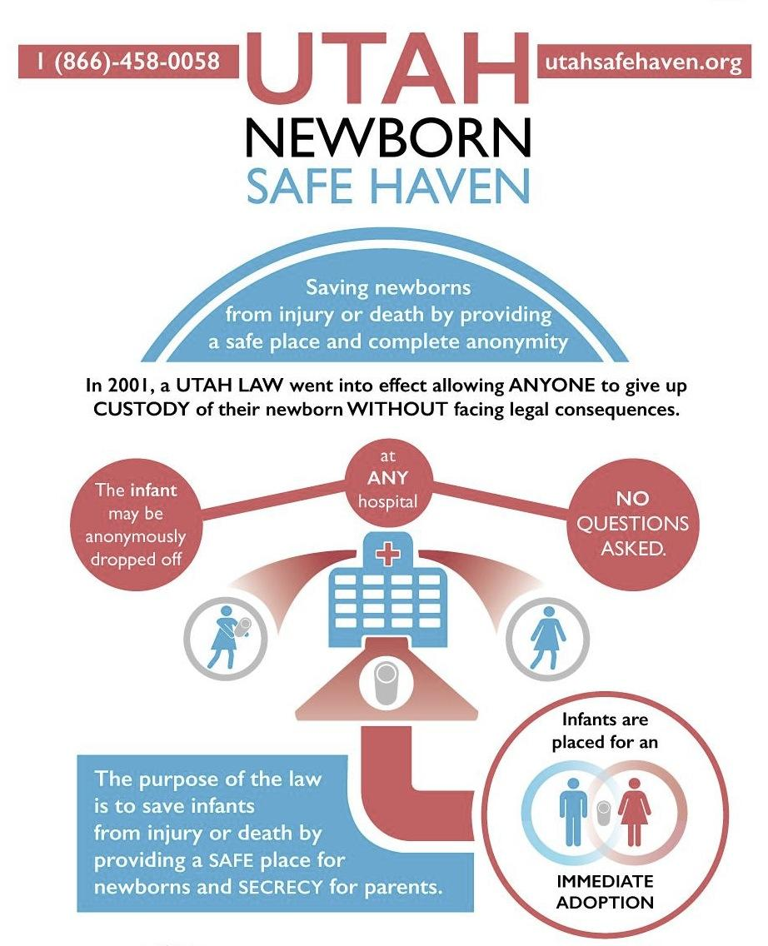
Notes:
In May 2001, a state-wide law went into effect in Utah allowing birth parents to anonymously relinquish custody of their newborn child “no questions asked” without facing any legal consequences.
Facts:
Any Utah hospital, open 24 hours, is designated as a “Safe Haven” for newborns to be dropped off safely.
The child must also be physically handed off to an employee of the hospital.
If an infant is left at a hospital, the mother remains anonymous and will not be reported to the police, investigated or criminally prosecuted.
DCFS then places the child for an immediate adoption.
Infants have already been saved under this procedure.
Utah was among the first group of states to pass a safe relinquishment law. All U.S. states have passed such laws.
The Utah Newborn Safe Haven has a toll free hotline (1-866-458-0058) available 24 hours a day 7 days a week. Representatives answer questions and concerns of all callers.
Reference:
“About.” Utah Newborn Safe Haven. 2012. Web. 12 January 2015. <http://www.utahsafehaven.org/About.html?page_id=2>
Utah Safe Haven (@UtahNewborn). “There is a safe place for newborns. No Questions. No Police. http://utahsafehaven.org ” 8 August 2014, 9:47 a.m. Tweet. <https://twitter.com/UtahNewborn/status/497786191098294272/photo/1>

Slide 13
The Adoption Process for Adoptive Families
Completed Home Study
Questionnaires
Family Background
Education & Employment
Relationships
Daily Life
Parenting
Neighborhood & Home
Religion/Belief System
Feelings about/readiness for adoption
Interviews
Background Checks
Home Inspection
Health Statements
Financial Statements
Letters of Reference
Training/Education
Finding a Child to Adopt
Domestic Newborn Adoption
Private
Agency
Lawyer
Foster Adoption
International Adoption
WAITING
Notes:
Quickly go over the process adoptive families go through to adopt. (Most students have little to no idea what is really involved.)
Make clear to students that never is money given to birth parents in exchange for their placing their child. Money is paid for services rendered during the adoption process. If a person is considering placing or adopting they should make sure they use reputable adoption professionals.
Hopeful Adoptive Parents must also decide which route they want to take to find their child. Briefly discuss each option and the costs associated. Also, that no matter what type of adoption they choose to pursue there is a considerable amount of time and effort put in on the part of Hopeful Adoptive Parents and a lot of time spent waiting to find their child. There is no average wait time. For some it can take weeks or months for others several years.
Average Costs
Newborn Domestic: $30,000 to $40,000+
(This goes to cover Home Study expenses, Court/Legal fees, Agency fees (counseling costs, advertising, birth parent expenses, etc.) and Medical expenses.
International: $40,000 to $60,000+
Foster Care: $0 to $2,5000
Reference:
Child Welfare Information Gateway. “Adoption Home Study Process.” Factsheets for Families. U.S. Department of Health & Human Services, 2010. Web. 9 Dec. 2014. <https://www.childwelfare.gov/pubs/f_homstu.cfm>
Child Welfare Information Gateway. “Costs of Adopting.” Factsheets for Families. U.S. Department of Health & Human Services, 2011. Web. 9 Dec. 2014. <https://www.childwelfare.gov/pubs/s_cost/index.cfm>

Slide 14
The Adoption Process for Expectant Parents
Decide if adoption is right for you.
Make an adoption plan
Do you want to work with an agency or an attorney?
Is anyone you know looking to adopt?
Import to have a good support group and seek counseling throughout the process.
Find an adoptive family.
Get to know the family and make a plan for placement.
Relinquishment
Life after placement
Counseling/ Support Groups
Continued Contact with Adoptive Family
Utah Adoption Laws
A birth mother may not consent to the adoption of her child until at least 24 hours after the birth.
The consent or relinquishment of a birth father may be executed at any time, including prior to the birth of the child.
The consent of an unmarried biological father is not required if the unmarried biological father fails to comply to requirements to initiate proceedings to establish his paternity of the child.
Notes:
Other important points:
There is no cost to place your child for adoption. (Again, make clear to students that never is money paid to birth parents in exchange for their placing their child.)
If a person is considering placing or adopting they should make sure they use a reputable agency (ask for references or contact the Office of Licensing and Better Business Bureau). Expectant parents should also understand that they should feel comfortable with the adoption professionals they choose to work with and if they don't feel comfortable they should speak up and/or choose another professional to work with.
When placing a child all information remains private and confidential.
Expectant parents can choose the type of adoption, create a hospital plan, and choose what type post-adoption contact is right for them.
With newborn domestic adoptions the baby goes home with adoptive family and is not in foster-care
They don’t have to have an adoption plan prior to giving birth in the hospital--they can still choose adoption after the baby is born.
Additionally just because they made an adoption plan before birth doesn’t mean that an expectant parent has to go through with placement. They are their child’s parents and cannot be coerced into any decision against their will.
Reference:
“The Adoption Process: Placing a Baby for Adoption.” American Adoptions. n.p., n.d. Web. 8 Feb 2015. <http://www.americanadoptions.com/pregnant/adoption_process>
“”Utah Adoption Act.” Utah Judicial Code Title 78B Chapter 6 Part 1 Sections101-146 .

Slide 15
Our Adoption Stories
Notes:
Please share with students your personal experience with adoption. What personally led you to choose to place/adopt your child? What was the process like? What emotions did you experience? Pictures and other visual aids always help to capture the students attention. Remember to allow time for students to ask questions. They are usually pretty curious.

